Slide 1
Lecture 7. System`s survivability indicators

Slide 2
Selecting vitality indicators - an important and crucial step of forming the theoretical foundations of the properties of the systems.

Slide 3
We impose the choice of survivability scorecards meet the following requirements:
a) on the semantic content of choice must meet the definition of property survivability systems;
b) The indicator should provide a sufficiently high level of systematic research;
c) measure should enable the development of models survivability systems available to conduct research and perform calculations;
d) indicator should be sensitive to manipulation at the level of properties of survivability characteristics.

Slide 4
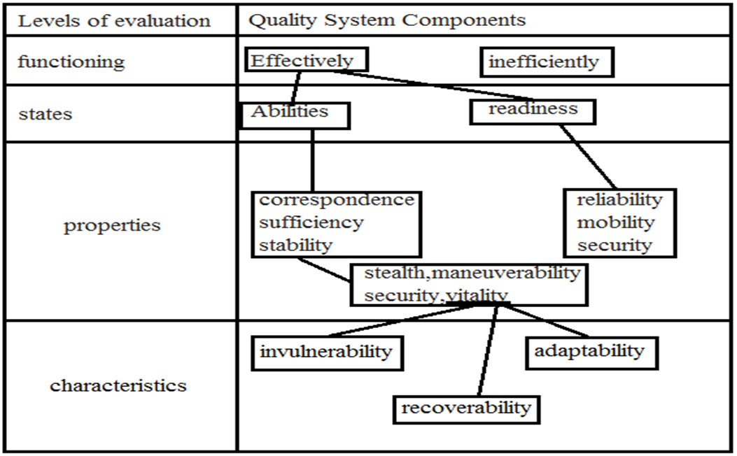
Hierarchical level of the system

Slide 5
The level of functioning as considered the highest level, providing a comprehensive assessment of the quality system. Selection indicator of vitality at this level ensures a systematic approach to research symptoms.
Search for a possible compromise between the desire to provide the systemic nature of research and the need to develop sufficiently simple and working models of vitality is associated with the analysis of systems of quality of the components in the two counter nanrav- leniyah: top - from the level of functioning of the system as intended and bottom - on system performance.

Slide 6
Consider a set of system properties, sufficiently determine its state power. For greater certainty distinguish the complex and private properties of the system. By the complex include:
- The stability of the property - property of the system to preserve the characteristics of the destination, and the resources necessary for the task, under specified conditions;

Slide 7
- Conformity of the property - property of the system to meet (comply with) its own characteristics destination requirements, providing a solution to the problem;
- The adequacy of the property - property of the system, determined by the availability of resources (material, energy, information, etc.) required for the task.

Slide 8
Stability of the system in an environment where the impact of PF is focused (combat conditions, terrorism), is defined by its stealth, agility, security, survivability, or combination of these properties. At a time when the impact of PF is unfocused in nature (natural disasters, accidents, etc.), stability of the system is determined by its maneuverability, ability to protect and vitality.

Slide 9
Thus, analysis, display the properties of survivability at different levels of assessment of quality systems makes it possible to conclude that the measure of survivability systems can be a quantitative measure of the chance to save the system state capacity after exposure to its elements damaging factors of natural disasters, weapons of war the enemy or emergency .

